Slide 1
DEVELOPMENT OF A MACHINE LEARNING BASED SYSTEM FOR ORE GRADE AND MINERAL DISTRIBUTION PREDICTION IN DU, BUKURU, JOS SOUTH LGA, PLATEAU STATE, NIGERIA
ARUM ALPHA AJIJI
UJ/2018/EN/0456
DEPARTMENT OF MINING ENGINEERING, UNIVERSITY OF JOS
SUPERVISED BY: MR. JOSHUA D. JORO
MARCH 2026

Slide 2
PRESENTATION OUTLINE
Background and problem statement
Aim and objectives
Significance of the study
Literature review & research gap
Study area
Methodology and Data
Machine learning models
Expected outcomes
Project timeline and budget
Conclusion

Slide 3
Background of the study
Bukuru lies in the younger granite province of jos plateau
Historically rich in cassiterite(tin) mineralization
Traditionally mining has contributed significantly to Nigeria's solid minerals
Declining ore grades and rising exploration costs demand smarter prediction tools
Traditional geostatistics (ordinary kriging, IDW) have limitations

Slide 4
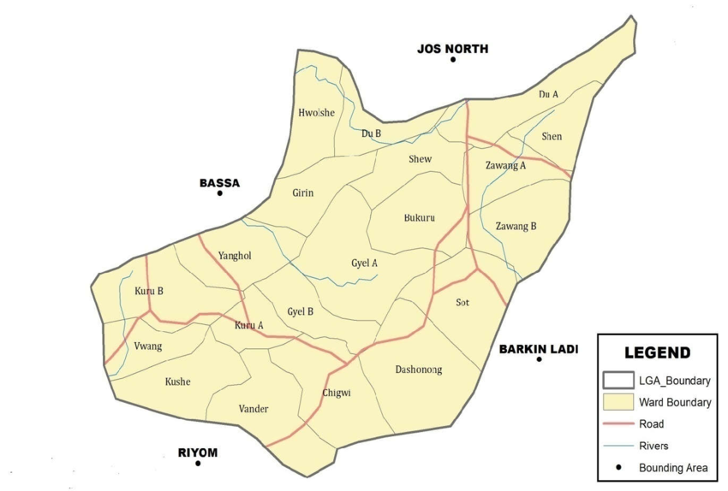
Map of the study area

Slide 5
STATEMENT OF THE PROBLEM
High uncertainty in ore grade estimation due to complex geology
Traditional methods assume linearity and stationarity
Consequences
Inefficient mine planning
poor reserve classification
increased drilling costs
Financial losses & environmental impact
Fragmented multi source data (geochemical, geophysical and spatial data)
Lack of localized ML system for Jos plateau

Slide 6
Aim and objectives
AIM:
To design and implement a machine learning based predictive system for accurate ore grade estimation and mineral distribution modelling in Bukuru, Jos, Nigeria
OBJECTIVES
Compile and preprocess multi source datasets
Develop and train supervised ML models(Random forest and XGBoost)
Compare performance with traditional geostatistical methods
Design a visualization board
Provide technical recommendations for exploration efficiency

Slide 7
Significance of the study
First localized ML system for Bukuru/jos plateau
Benefits:
Mining engineers & exploration companies
Policymakers & sustainable mining
Reduced financial & environmental risk
Technology advancement in Nigerian mining sector

Slide 8
LITERATURE REVIEW – KEY INSIGHTS
Geostatics (Kriging)- assumes stationarity (Goovaerts, 1997)
Machine learning outperforms in complex terrains
Random forest and XGBoost successfully used in mineral prospectivity (Rodriguez Galiano et al., 2015)
Ensemble methods handle nonlinear relationships better

Slide 9
RESEARCH GAP
Very few studies focus specifically on Jos plateau/Bukuru
Most research uses single source data
No integrated multi source ML dashboard for tin mineralization in the region
Opportunity: localized, data driven system tailored to younger Granite geology

Slide 10
STUDY AREA – BUKURU, JOS SOUTH
LOCATION: Jos south LGA, plateau state
Geological setting: Younger granite ring complexes
Key features: cassiterite(SnO2), hydrothermal alteration, fractures
Historical tin mining area

Slide 11
DATA REQUIREMENTS
Geochemical: SN, K, Fe, Cu, Pb, ZN……..
Geophysical: Total magnetic intensity, Radiometric (k, Th, U)
Spatial: Coordinates, DEM, slope , aspect, distance to faults

Slide 12
Methodology workflow
Data acquisitions & integration
Preprocessing & EDA
Feature engineering
Model development (RF & XGBoost)
Validation & spatial prediction
Dashboard deployment

Slide 13
Machine learning Models
Random forest regressor; Robust, feature importance
XGBoost Regressor; high accuracy and handles missing values
Baselines; Linear Regression
Evaluation; RMSE, MAE, R^2 (Coefficient of determination),MAPE
70/15/15 train-val-test split +k fold cross validation

Slide 14
Expected outcomes & deliverables
Validated Ml ore grade prediction model
High resolution mineral distribution maps
Interactive web based dashboard (Next.js + react leaflet)
Technical recommendations for exploration
Full final year project report

Slide 15
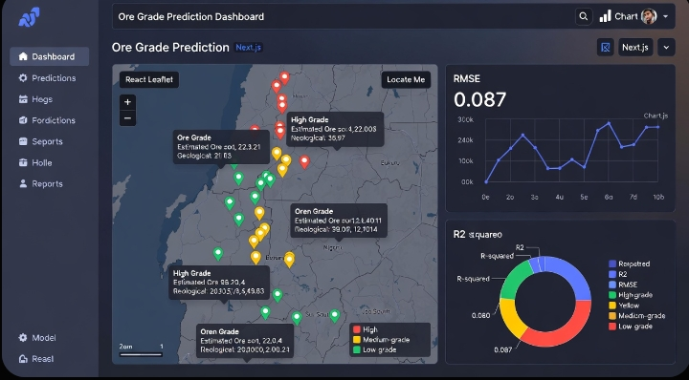

Slide 16
PROJECT TIMELINE
Project timeline
S/N | Research activity | January | February | March | April | May | June
1 | Topic selection and supervisor’s approval
2 | Literature review and proposal development
3 | DATA COLLECTION
4 | Date acquisition
5 | MODEL TRAINING
6 | Field validation
7 | Report writing
8 | Review and submission

Slide 17
PRELIMINARY BUDGET
ITEM | COST
DATA ACQUISITION | 50000
SOFTWARE AND TOOLS | 150000
RESEARCH ASSISTANCE | 100000
MISCELLANEOUS TOTAL | 100000 400000

Slide 18
CONCLUSION
Traditional methods are limited in Bukuru's complex geology
Machine learning offers superior accuracy and risk reduction
This project will deliver Nigerias first localized ML ore prediction for tin
Ready for sustainable and data driven mining future

Slide 19
THANK YOU

